Slide 1
Web Operation Report
20151012
April

Slide 2

Web OP Metrics _ Web
Monthly average UV, PV and orders of the website
八月UV大幅上升冲淡转化率，九月回归到之前水平且略有增长

Slide 3
Web OP Metrics _ Web new
Monthly average UV, PV and orders of the website
UV较之8月大幅下降，外国转化率下降明显

Slide 4
Web OP Metrics _ Web old
Monthly average UV, PV and orders of the website
老客转化率持续上升

Slide 5
Web OP Metrics _ Device
Monthly average Revenue of PC, Pad, Phone (Android orders are very low)
Month | Web |  |  | Pad |  |  | Phone
 | Chinese | Expat | Total | Chinese | Expat | Total | Chinese | Expat | Total
March | 60% | 81% | 74% | 5% | 6% | 6% | 35% | 13% | 21%
April | 62% | 82% | 74% | 6% | 6% | 6% | 32% | 12% | 20%
May | 60% | 80% | 72% | 11% | 9% | 10% | 29% | 10% | 18%
June | 62% | 79% | 71% | 12% | 10% | 11% | 26% | 11% | 18%
July | 64% | 81% | 72% | 14% | 8% | 11% | 22% | 11% | 17%
August | 74% | 82% | 74% | 15% | 11% | 13% | 11% | 7% | 13%
September | 84% | 73% | 78% | 9% | 13% | 11% | 7% | 14% | 11%

Slide 6
Web OP Metrics _ AOS
Device AOS in September
With more promotion info, web keeps higher AOS
Device | Expat | Chinese | Total
Android | 488 | 258 | 315
IPAD | 518 | 281 | 332
IPHONE | 436 | 308 | 334
WEB | 519 | 333 | 407
Total | 512 | 320 | 386
客单价没有太大变化，只有小幅的波动

Slide 7
Payment _ the COD decreased since less expat, the
Trend didn’t change a lot
Revenue percentage by payment 20150801-20150831
Payment | Expat |  |  |  | Chinese |  |  |  | Total
 | Android | IPAD | IPHONE | WEB | Android | IPAD | IPHONE | WEB | Android | IPAD | IPHONE | WEB
PAYPAL | 0% | 4% | 2% | 6% | 0% | 0% | 0% | 1% | 0% | 1% | 0% | 3%
得仕卡 | 0% | 0% | 0% | 0% | 0% | 0% | 0% | 0% | 0% | 0% | 0% | 0%
货到付款(POS机刷卡) | 33% | 28% | 39% | 16% | 25% | 32% | 34% | 20% | 26% | 31% | 35% | 19%
货到付款(现金) | 67% | 53% | 45% | 66% | 4% | 12% | 14% | 29% | 11% | 23% | 20% | 42%
微信 | 0% | 4% | 0% | 2% | 0% | 13% | 0% | 20% | 0% | 11% | 0% | 14%
信用卡在线支付(通过PayPal支付) | 0% | 3% | 2% | 4% | 0% | 0% | 0% | 0% | 0% | 1% | 0% | 1%
余额支付 | 0% | 1% | 0% | 1% | 8% | 3% | 3% | 7% | 7% | 2% | 3% | 5%
银行 | 0% | 0% | 0% | 1% | 1% | 0% | 0% | 4% | 0% | 0% | 0% | 2%
支付宝 | 0% | 7% | 9% | 3% | 58% | 33% | 44% | 14% | 52% | 26% | 37% | 10%
支付宝 WEB | 0% | 0% | 2% | 0% | 4% | 7% | 4% | 4% | 4% | 5% | 4% | 3%
总计 | 100% | 100% | 100% | 100% | 100% | 100% | 100% | 100% | 100% | 100% | 100% | 100%
Revenue percentage by payment 20150901-20150930
Payment | Expat |  |  |  | Chinese |  |  |  | Total
 | Android | IPAD | IPHONE | WEB | Android | IPAD | IPHONE | WEB | Android | IPAD | IPHONE | WEB
货到付款(现金) | 47% | 44% | 45% | 64% | 2% | 9% | 11% | 33% | 19% | 21% | 20% | 47%
货到付款(POS机刷卡) | 0% | 37% | 40% | 19% | 34% | 31% | 39% | 23% | 21% | 33% | 39% | 21%
支付宝 | 21% | 4% | 7% | 2% | 56% | 33% | 43% | 17% | 42% | 24% | 33% | 10%
微信 | 32% | 2% | 0% | 1% | 5% | 17% | 0% | 16% | 15% | 12% | 0% | 9%
PAYPAL | 0% | 9% | 5% | 8% | 0% | 0% | 0% | 1% | 0% | 3% | 1% | 4%
招商银行 | 0% | 0% | 0% | 2% | 0% | 0% | 0% | 4% | 0% | 0% | 0% | 3%
支付宝 WEB | 0% | 1% | 1% | 0% | 3% | 8% | 6% | 4% | 2% | 6% | 5% | 2%
信用卡在线支付(通过PayPal支付) | 0% | 3% | 1% | 4% | 0% | 0% | 0% | 0% | 0% | 1% | 1% | 2%
余额支付 | 0% | 0% | 0% | 0% | 0% | 1% | 1% | 1% | 0% | 1% | 1% | 0%
得仕卡 | 0% | 0% | 0% | 0% | 0% | 0% | 0% | 0% | 0% | 0% | 0% | 0%
总计 | 100% | 100% | 100% | 100% | 100% | 100% | 100% | 100% | 100% | 100% | 100% | 100%

Slide 8
Web OP Metrics _ EDM
Date | Title | Email send | Accept | Accept rate | Benchmark | Open | Open rate | Benchmark | Click | Click rate | Benchmark | orders | Conversion rate | ROI
9月25日 | 团购海陆盛宴仅需199！生蚝季教你如何嫁入“蚝”门！ | 4319 | 4235 | 98.1% | 96% | 445 | 10.3% | 7.13% | 91 | 2.1% | 1.20% | 4 | 0.1% | 19
9月18日 | 鳕鱼三份99周末特惠！西区老大房全线登场！团购牛肉大闸蟹199速抢！ | 3154 | 3135 | 99.4% | 96% | 398 | 12.6% | 7.13% | 102 | 3.2% | 1.20% | 8 | 0.3% | 52
9月11日 | 99元吃完羊排再吃黄金蟹；牛排大闸蟹超值团购第二波199疯抢！ | 3185 | 3140 | 98.6% | 96% | 467 | 14.7% | 7.13% | 133 | 4.2% | 1.20% | 4 | 0.1% | 32
9月2日 | 得撒石磨豆腐重磅上市！西班牙国宝级5J火腿低至4折！ | 2,533 | 2,500 | 98.7% | 96% | 313 | 12.4% | 7.13% | 87 | 3.4% | 1.20% | 5 | 0.2% | 29
8月28日 | 甫田团购最后四天！清新周末一起享受烘培乐趣吧，更有嘉年华免费邀请你来玩！ | 2,559 | 2.497 | 97.6 | 96% | 449 | 17.5% | 7.13% | 113 | 4.4% | 1.20% | 2 | 0.1% | 11
8月21日 | 久等啦！快来扫码参与甫田超值团购；黑毛猪月饼重磅回归；买巴黎水送Monbento！ | 1,745 | 1,692 | 97% | 96% | 287 | 16.45% | 7.13% | 73 | 4.18% | 1.20% | 3 | 0.17% | 32
8月14日 | 福利不停：最放心的鸡肉特惠来袭，精品葡萄65折，周末青口超值组，关注微信还送巴黎水！ | 1,167 | 1,133 | 97% | 96% | 151 | 12.94% | 7.13% | 32 | 2.74% | 1.20% | 2 | 0.17% | 32
8月7日 | 众多福利来袭：八月首单15%返现，三文鱼买一送一，冰激凌买三送一！ | 902 | 855 | 95% | 96% | 151 | 16.74% | 7.13% | 36 | 3.99% | 1.20% | 6 | 0.67% | 87
9月18日 较吸引人的标题和内容 ROI和转换率有所上升

Slide 9
Promotion summary _ 加价购
8/31-9/7 | 满238加价
Product Sku | Product Zh Name | Product Unit | Price | Revenue | CN order | order% | EN order | order%
A-0003-0295 | 澳洲 谷饲 牛西冷（100天） | 200g | 38 | 13017 | 164 | 10% | 185 | 18%
9/8—9/14 | 满238加价
Product Sku | Product Zh Name | Product Unit | Price | Revenue | CN order | order% | EN order | order%
D-064-0135 | 哈根达斯 小杯曲奇香奶冰激凌 | 77g | 18 | 3682 | 131 | 9% | 131 | 16%
9/15-9/21 | 满238加价
Product Sku | Product Zh Name | Product Unit | Price | Revenue | CN order | order% | EN order | order%
A-0003-0334 | 台湾 麻豆文旦柚 | 250g | 40 | 4022 | 27 | 2% | 58 | 6%
A-0003-0335 | 红心猕猴桃 | 500g | 40 | 3176 | 49 | 3% | 33 | 4%
A-0003-0336 | 泉芙寇 水润啫喱 | 500g | 18 | 856 | 9 | 1% | 39 | 4%
 |  |  |  |  |  | 5% |  | 14%
9/22-9/28 | 满238加价
Product Sku | Product Zh Name | Product Unit | Price | Revenue | CN order | order% | EN order | order%
A-0003-0334 | 台湾 麻豆文旦柚 | 2pcs | 42 | 1828 | 35 | 2% | 16 | 2%
A-0003-0335 | 红心猕猴桃 | 4pcs (300~350g) | 18 | 396 | 15 | 1% | 7 | 1%
A-0003-0336 | 泉芙寇 水润啫喱 | 60ml | 20 | 297 | 6 | 0% | 11 | 2%
 |  |  |  |  |  | 4% |  | 5%
9/29-10/8 | 满238加价
Product Sku | Product Zh Name | Product Unit | Price | Revenue | CN order | order% | EN order | order%
A-0003-0350 | FIELDS优选 无激无抗散养红标鸡 翅根 | 200-300g/3-4pcs | 21 | 3283 | 79 | 6.3% | 82 | 7.4%
*-

Slide 10
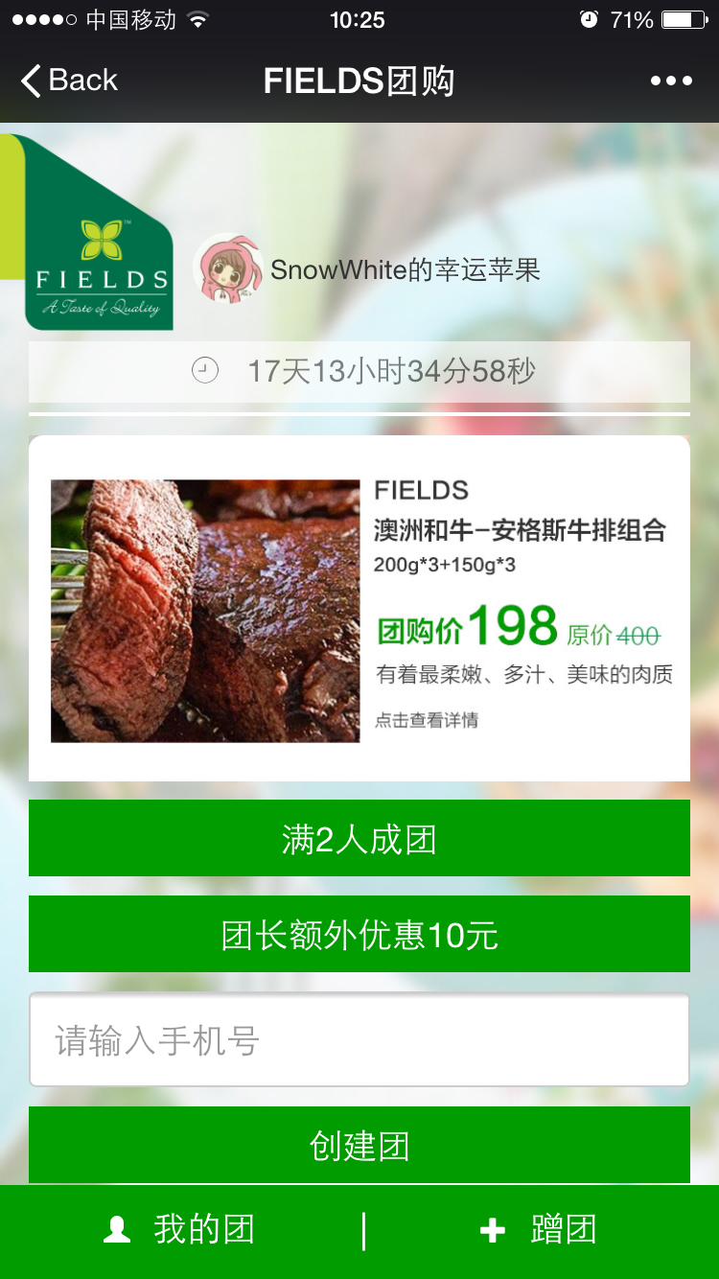
WeChat group buy
商品名称 | 促销进价时间段 | 常规售价 | 促销售价
阳澄湖 精品大闸蟹礼券（3对，雌：2.3-2.5两；雄：3.3-3.5两） | 9.10-10.31 | 498 | 199
[微信团购] 澳洲和牛+安格斯 炖煮2.1公斤超值组 | 9.10-10.8 | 418 | 199
[微信团购]海陆盛宴超值拼盘 | 9.24-10.31 | 422 | 199
数据截止至：2015/10/8
SKU | Name | Group Number | 参团人数 | 购买人数 | 购买率 | 购买金额 | 平均参团 人数
A-0003-0307 | 澳洲和牛+安格斯 炖煮2.1公斤超值组 | 582 | 2614 | 1255 | 48% | 228,837 | 4.5
A-0003-0341 | 海陆盛宴超值拼盘 | 205 | 893 | 342 | 38% | 62,214 | 4.4
M-044-1389 | 阳澄湖精品大闸蟹礼券 | 207 | 615 | 212 | 34% | 38,558 | 3.0
总计 |  | 994 | 4122 | 1809 | 44% | 329,609 | 4.1

Slide 11
WeChat group buy – customer behavior analysis about the group size
SKU | Product Name | 判断 | 团数 | 占比 | 参团人数 | 占比 | 购买人数 | 占比 | Revenue | 占比
A-0003-0307 | 澳洲和牛+安格斯 炖煮2.1公斤超值组 | 10人团 | 64 | 11% | 640 | 24% | 352 | 24% | 66,792 | 29%
 |  | 7-9人团 | 129 | 22% | 1,035 | 40% | 566 | 40% | 101,028 | 44%
 |  | 3-6人团 | 136 | 23% | 626 | 24% | 279 | 24% | 49,795 | 22%
 |  | 2人及以下团 | 253 | 43% | 313 | 12% | 58 | 12% | 11,222 | 5%
 |  | 总计 | 582 | 100% | 2,614 | 100% | 1,255 | 100% | 228,837 | 100%
A-0003-0341 | 海陆盛宴超值拼盘 | 10人团 | 32 | 16% | 320 | 36% | 153 | 45% | 29,050 | 47%
 |  | 7-9人团 | 33 | 16% | 274 | 31% | 140 | 41% | 24,439 | 39%
 |  | 3-6人团 | 39 | 19% | 167 | 19% | 45 | 13% | 7,940 | 13%
 |  | 2人及以下团 | 101 | 49% | 132 | 15% | 4 | 1% | 785 | 1%
 |  | 总计 | 205. | 100% | 893 | 100% | 342 | 100% | 62,214 | 100%
M-044-1389 | 阳澄湖精品大闸蟹礼券 | 10人团 | 10 | 5% | 100 | 16% | 35 | 17% | 6,646 | 17%
 |  | 7-9人团 | 18 | 9% | 141 | 23% | 53 | 25% | 9,521 | 25%
 |  | 3-6人团 | 52 | 25% | 222 | 36% | 75 | 35% | 13,546 | 35%
 |  | 2人及以下团 | 127 | 61% | 152 | 25% | 49 | 23% | 8,845 | 23%
 |  | 总计 | 207 | 100% | 615 | 100% | 212 | 100% | 38,558 | 100%

Slide 12
WeChat group buy – customer behavior analysis about the date trend
SKU | Product Name | date | 团数 | 占比 | 参团人数 | 占比 | 购买人数 | 占比 | Revenue | 占比
A-0003-0252 | 澳洲和牛-安格斯牛排 | 2015910 | 266 | 46% | 2659 | 46% | 575 | 46%
 |  | 2015911 | 17 | 3% | 146 | 3% | 32 | 3%
 |  | 2015912 | 15 | 3% | 150 | 3% | 68 | 5%
 |  | 2015913 | 11 | 2% | 110 | 2% | 37 | 3%
 |  | 2015914 | 65 | 11% | 650 | 11% | 101 | 8%
 |  | 2015915 | 29 | 5% | 290 | 5% | 75 | 6%
 |  | 2015916 | 14 | 2% | 140 | 2% | 61 | 5%
 |  | 2015917 | 6 | 1% | 60 | 1% | 28 | 2%
 |  | 2015918 | 69 | 12% | 690 | 12% | 139 | 11%
 |  | 2015919 | 11 | 2% | 110 | 2% | 20 | 2%
 |  | 2015920 | 13 | 2% | 130 | 2% | 48 | 4%
 |  | 2015921 | 3 | 1% | 30 | 1% | 2 | 0%
 |  | 2015922 | 10 | 2% | 100 | 2% | 22 | 2%
 |  | 2015923 | 7 | 1% | 70 | 1% | 7 | 1%
 |  | 2015924 | 13 | 2% | 130 | 2% | 8 | 1%
 |  | 2015925 | 13 | 2% | 130 | 2% | 5 | 0%
 |  | 2015100 | 2 | 0% | 20 | 0% | 3 | 0%
 |  | 2015101 | 6 | 1% | 60 | 1% | 8 | 1%
 |  | 2015102 | 1 | 0% | 10 | 0% | 0 | 0%
 |  | 2015104 | 1 | 0% | 10 | 0% | 0 | 0%
 |  | 2015105 | 2 | 0% | 20 | 0% | 5 | 0%
 |  | 20151007 | 6 | 1% | 33 | 1% | 11 | 1%
 |  | 20151008 | 2 | 0% | 4 | 0% | 0 | 0%
总计 |  |  | 582 | 100% | 5752 | 100% | 1255 | 100%

Slide 13
WeChat group buy – customer behavior analysis about the date trend
SKU | Product Name | date | 团数 | 占比 | 参团人数 | 占比 | 购买人数 | 占比 | Revenue | 占比
A-0003-0253 | 美国真鳕鱼排2片装*4 + 英国黄金蟹*1 | 2015/8/17 | 3 | 3% | 15 | 3% | 4 | 2% | 5,960 | 3%
 |  | 2015/8/18 | 23 | 22% | 132 | 27% | 57 | 30% | 45,550 | 24%
 |  | 2015/8/19 | 16 | 15% | 51 | 10% | 24 | 13% | 30,984 | 17%
 |  | 2015/8/20 | 4 | 4% | 13 | 3% | 7 | 4% | 7,940 | 4%
 |  | 2015/8/21 | 11 | 11% | 99 | 20% | 35 | 19% | 21,700 | 12%
 |  | 2015/8/22 | 26 | 25% | 131 | 26% | 39 | 21% | 46,306 | 25%
 |  | 2015/8/23 | 6 | 6% | 34 | 7% | 10 | 5% | 10,407 | 6%
 |  | 2015/8/24 | 13 | 13% | 20 | 4% | 11 | 6% | 16,308 | 9%
 |  | 2015/8/25 | 2 | 2% | 0 | 0% | 0 | 0% | 1,194 | 1%
总计 |  |  | 104 | 100% | 495 | 100% | 187 | 100% | 186,349 | 100%

Slide 14
WeChat group buy – customer behavior analysis about the date trend
SKU | Product Name | date | 团数 | 占比 | 参团人数 | 占比 | 购买人数 | 占比 | Revenue | 占比
A-0003-0254 | 兰维乐 麦卢卡蜂蜜6+ 两瓶半价组 | 2015/8/17 | 3 | 8% | 20 | 13% | 12 | 18% | 5,910 | 9%
 |  | 2015/8/18 | 11 | 30% | 69 | 45% | 30 | 45% | 21,680 | 31%
 |  | 2015/8/19 | 9 | 24% | 30 | 19% | 11 | 17% | 17,186 | 25%
 |  | 2015/8/20 | 2 | 5% | 7 | 5% | 2 | 3% | 3,752 | 5%
 |  | 2015/8/21 | 1 | 3% | 10 | 6% | 4 | 6% | 1,980 | 3%
 |  | 2015/8/22 | 6 | 16% | 14 | 9% | 4 | 6% | 11,840 | 17%
 |  | 2015/8/24 | 2 | 5% | 4 | 3% | 3 | 5% | 3,950 | 6%
 |  | 2015/8/25 | 3 | 8% | 0 | 0% | 0 | 0% | 3,168 | 5%
总计 |  |  | 37 | 100% | 154 | 100% | 66 | 100% | 69,466 | 100%

Slide 15
新品完成进度
Category | 20158 |  |  | 20159
 | To be introduced | Finished | Total | To be introduced | Finished | Total
other | 12 | 48 | 60 | 5 | 58 | 63
Bakery | 20 | 8 | 28 | 10 | 19 | 29
Beverages | 4 | 22 | 26 |  | 2 | 2
Dairy | 5 | 54 | 59 |  | 30 | 30
Fish & Seafood |  | 10 | 10 | 2 | 19 | 21
Fruit | 2 | 37 | 39 |  | 48 | 48
Gift | 5 | 23 | 28
Grain &amp; Oil | 2 | 3 | 5 | 2 |  | 2
Home &amp; Outdoor | 3 | 14 | 17 | 12 | 27 | 39
Home Care | 3 | 0 | 3 | 7 | 34 | 41
Maternity &amp; Baby | 3 | 9 | 12 | 14 | 26 | 40
Meat | 2 | 23 | 25 | 8 | 14 | 22
Pantry | 7 | 47 | 54
Pet | 0 | 3 | 3 |  | 16 | 16
Ready to Serve | 6 | 2 | 8 | 1 | 55 | 56
Seasoning | 10 | 30 | 40 |  | 3 | 3
Snacks | 2 | 24 | 26 | 8 |  | 8
Vegetables |  | 3 | 3 | 4 | 8 | 12
Wines & Beer | 0 | 0 | 0 | 11 | 39 | 50
总计 | 86 | 357 | 443 | 84 | 398 | 482
New product number every month
Month | New product No.
Mar | 233
Apr | 270
May | 370
Jun | 385
Jul | 629
Aug | 443
Sep | 398
Total | 2728
*

Slide 16
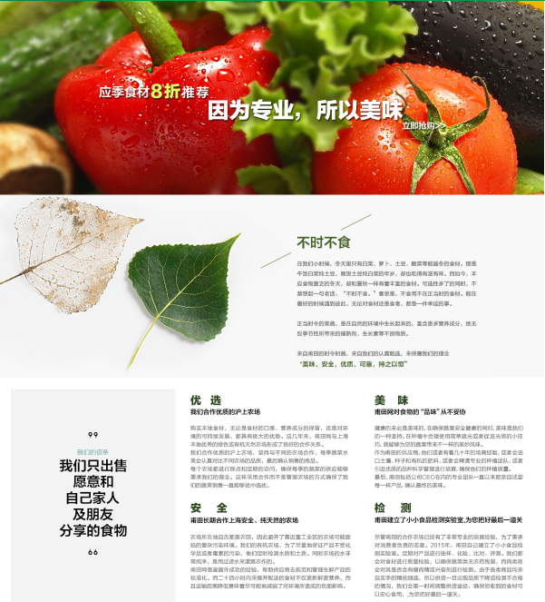

Key Promotion in September
Organic and Seasonal (Key promotion)
Seasonal and main organic products 20% off
Seasonal: we will mainly focus on our professional with vege and fruit
Organic: we will focus on dirty dozen to emphasis the importance of organic

Slide 17
Other Promotions in September
BBQ (9/20-10/20)
Talk about BBQ products with discount
Pears (9/20-10/15)
Mainly about all the pears
Maternity (10/1-10/20)
Promotions with gift for the maternity products
Taste of Shanghainess (September)
Buy chicken get nice gift
Second half price (10/12-10/31) key promotions
All categories get part products second half price
Air pollution (10/20-11/12)
All the air pollution related products with low price
Halloween
Halloween selections with discount

Slide 18
Main project and change
甫田精选
IT预期9月12日完成所有的调整上线
APP
与IT沟通APP首页，促销页面，购物车页面的调整中
新广告法
更改问题页面中
商品详描
每天制作1个商品详描进度中

